Slide 1



Opening up the black box: Explainable AI
Ryan Wesslen
The views, information, or opinions expressed in this presentation are solely those of the author and do not necessarily represent those of UNC Charlotte, Charlotte Visualization Center, or Pacific Northwest National Laboratory or any other organization.

Slide 2
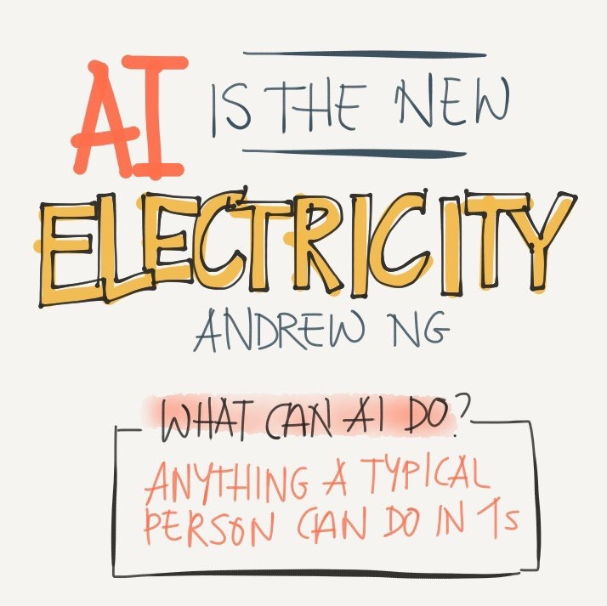
Andrew Ng; @TessFerrandez
Notes:
Researchers are painting an even broader optimism on AI, so far as to declare that “AI” is the new electricity. In that, as electricity resulted in a complete economic and technological change in the 20th century, researchers like Stanford’s Andrew Ng are tapping AI to be the next driver of such growth for the near future.
What is the mechanism? Ng argues that now AI can perform at or above human level for nearly any task that a person can do in one second. His logic follows that by automating such individual tasks, labor can be more productive
“it has the ability to unlock new kinds of labor.”
Carnegie Mellon Jason Hong,
“Automobiles were a direct replacement for horses, but in the medium and long-term led to many other kinds of uses, such as semi-trucks for large scale shipping, moving vans, mini vans, convertibles,” Hong said.
“Similarly, AI systems in the short term will be a direct replacement for routine kinds of tasks, but in the medium and long-term we will see uses just as dramatic as automobiles.”

Slide 3
Notes:
With the recent growth, AI in general has been tabbed as a major generator of future productivity gains.
One optimistic study by Accenture and Frontier Economics, estimated that AI has the potential to nearly double growth rates in many developed countries.

Slide 4
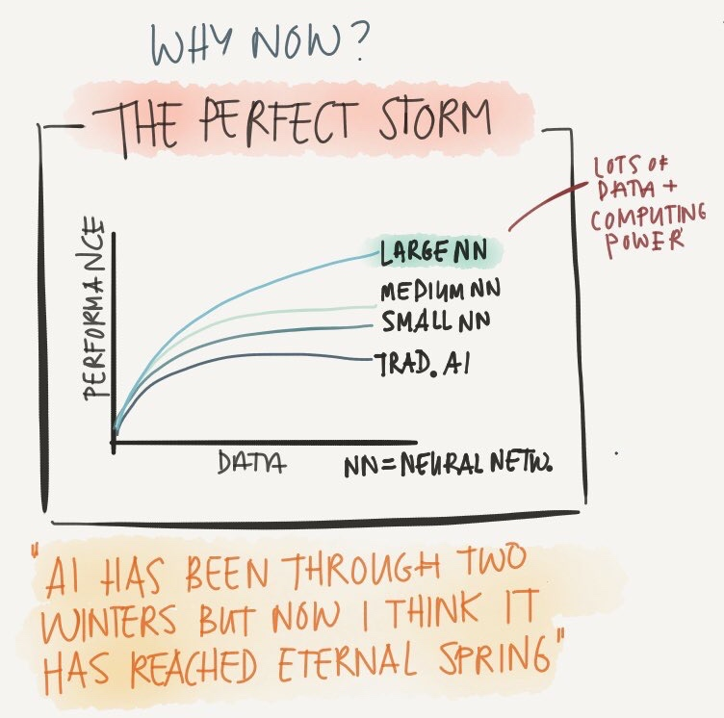
Large Neural Networks = Deep Learning!
Andrew Ng; @TessFerrandez
Notes:
While AI has been around for decades, what’s driving this growth?
Large neural networks or “deep learning”.
-Traditional AI and Machine Learning performance gained with more data up to a point.
-While small and medium neural networks have some "economies of scale" of data, the major breakthrough occurred with combination of the "big data" era + computing power
Researchers like Ng are so optimistic on Deep Learning's potential to continue such gains to quote "AI has now reached eternal spring"

Slide 5
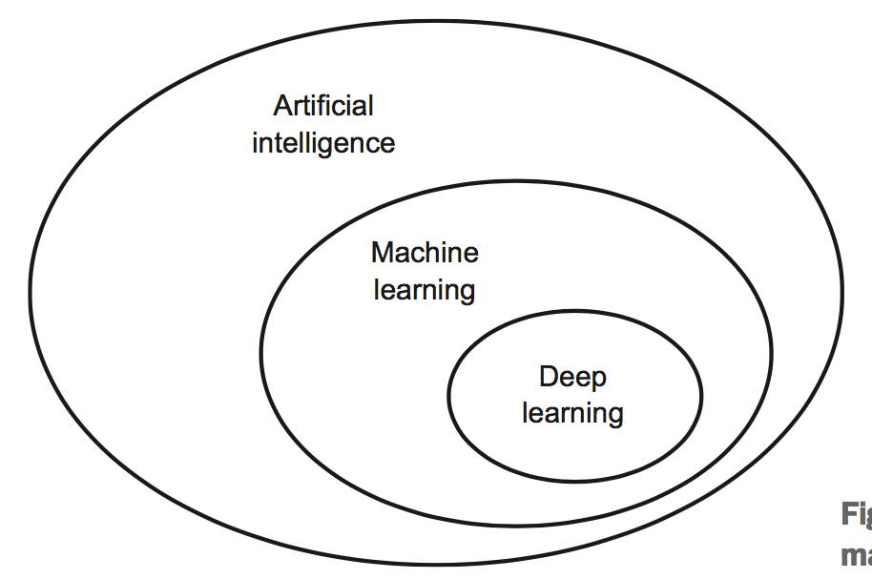
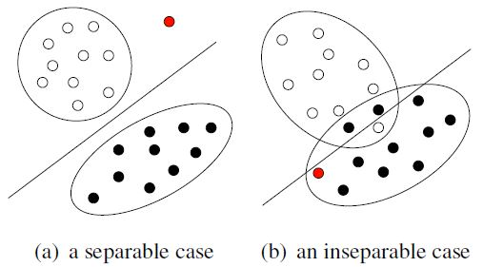
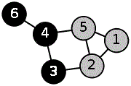
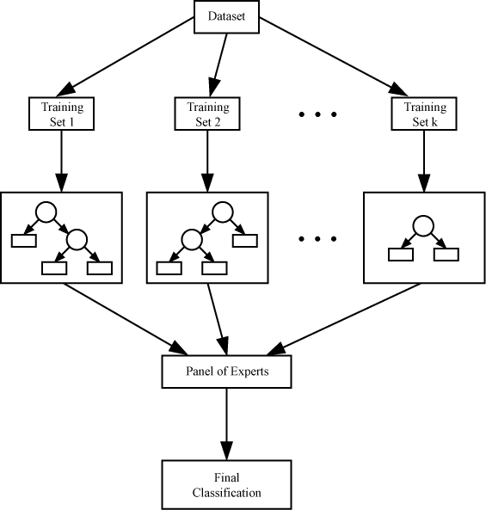
Knowledge Systems
Planning Problems
SVM
Search Algorithms
Decision Trees & Ensembles
Adapted from Chollet (2018)
Notes:
One way to think of it is that AI is a broad discipline of computer science in which “Machine Learning” is a subset.
Similarly, “Deep Learning” is a subset of “Machine Learning”.

Slide 6
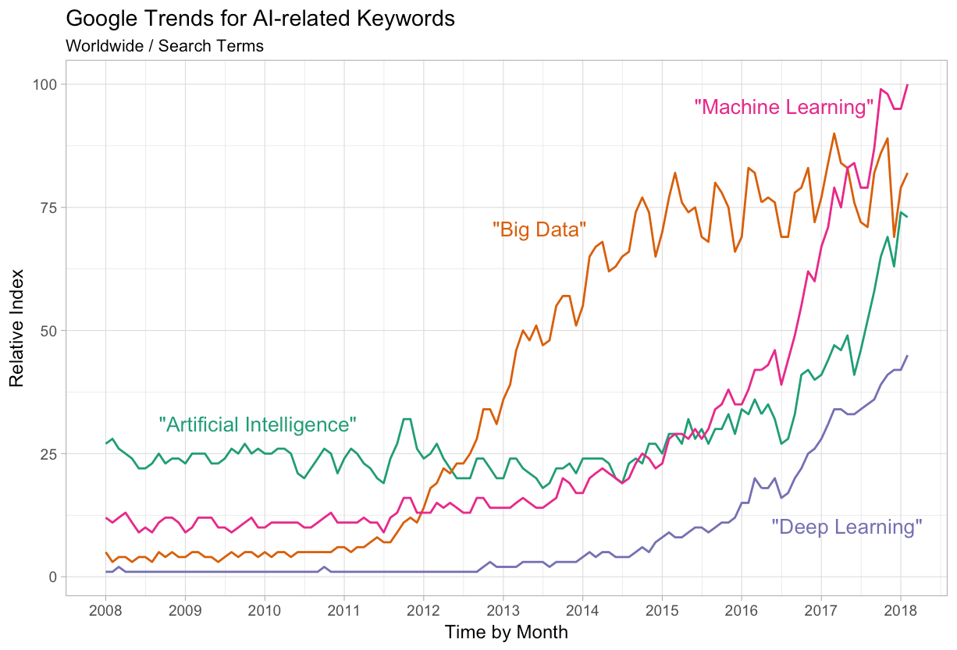
3
2
1
Google Trends
Notes:
Over the last 10 years, interest in AI has increased rapidly. One way to measure the growth is through Google Trends.
10 years ago (point 1), Artificial Intelligence was the most well known while others like Big Data and Machine Learning were very small.
Around 2012-2014 (point 2), “Big Data” became the hot term, rising quickly while “Artificial Intelligence” and “Machine Learning” made only nominal gains.
However, in recent years (point 3), “Machine Learning” has risen dramatically and surpassed “Big Data” in mid 2017. A major contributor to “Machine Learning’s” rise is the growth of “Deep Learning,” a term that didn’t show up until 2012 but has risen quickly in the last two years.

Slide 7
Advances in Deep Learning
Fjodor van Veen, Asimov Institute
Notes:
So let's review what are some of the advances in deep learning...

Slide 8
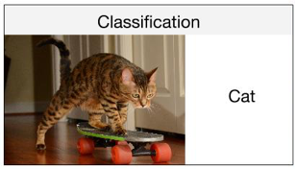
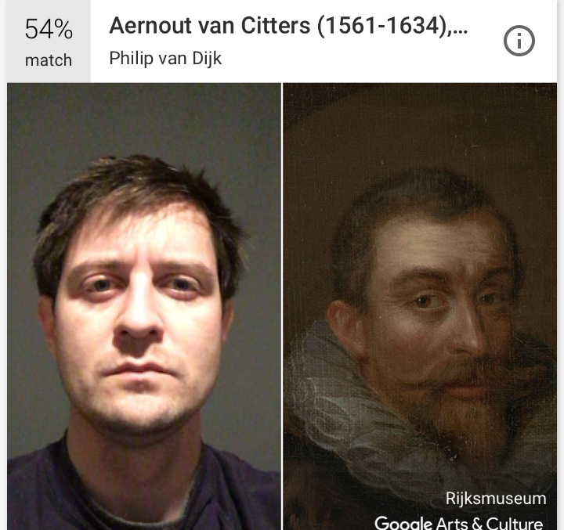
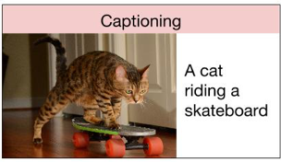
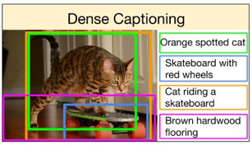
Image Recognition
Andrej Karpathy
Google Arts & Culture App
Notes:
In image recognition, deep learning has accelerated computer scientists ability to classify images, such as models that can use an image of a cat as input and return "cat" as the predicted object.
More advanced systems have improved captioning to denote not only that there is a cat in an image but also related actions or objects to output that "a cat is riding a skateboard"
This has lead to even more sophisticated models for dense captioning to identify multiple captioning within an image.
Alternatively, image recognition also facilitate facial recognition and similarity measures like Google Arts & Culture App that allows individuals to capture their own image and Google to quickly identify the work of art with the most similar face.

Slide 9
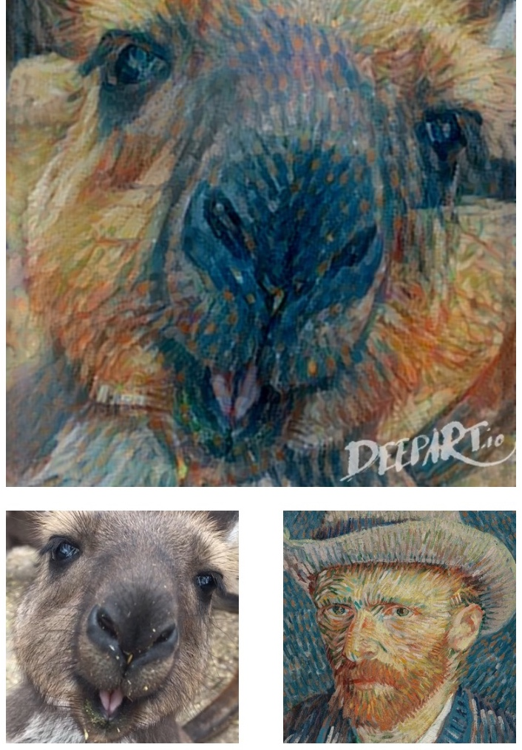
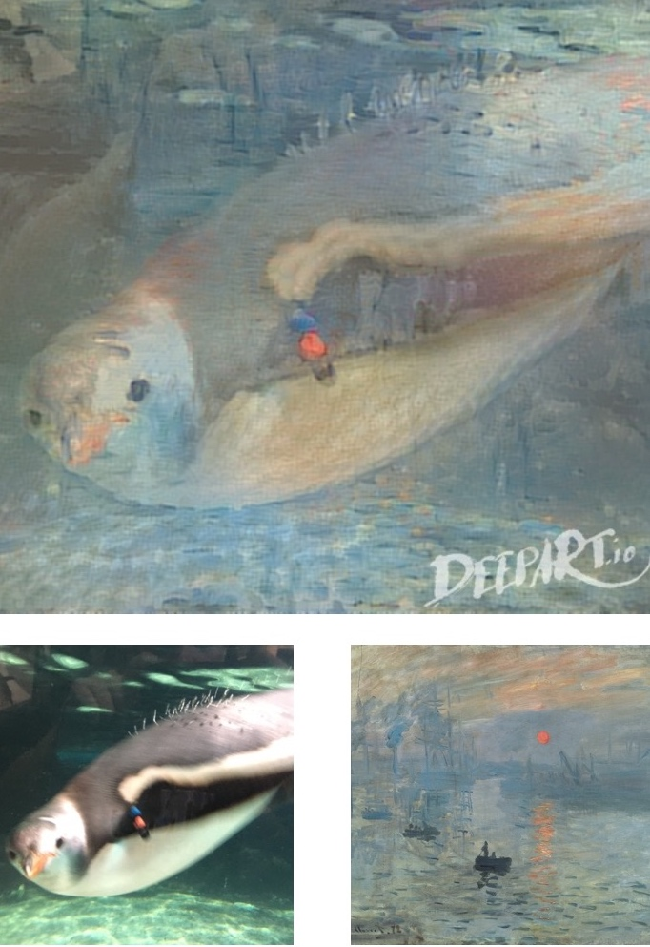
VanGogh-roo
Monet-guin
DeepArt.io
Notes:
Further advances have yielded the ability to transfer styles, as in these examples from the website DeepArt.io.
I uploaded an image of a Kangaroo and Van Gogh's self portrait to create "VanGogh-roo". Or alternatively supply an image of a penguin and a Monet painting to yield "Monet-guin"

Slide 10
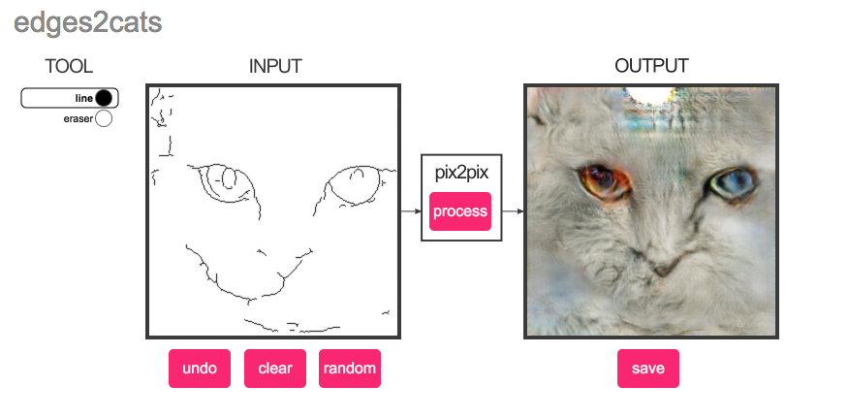
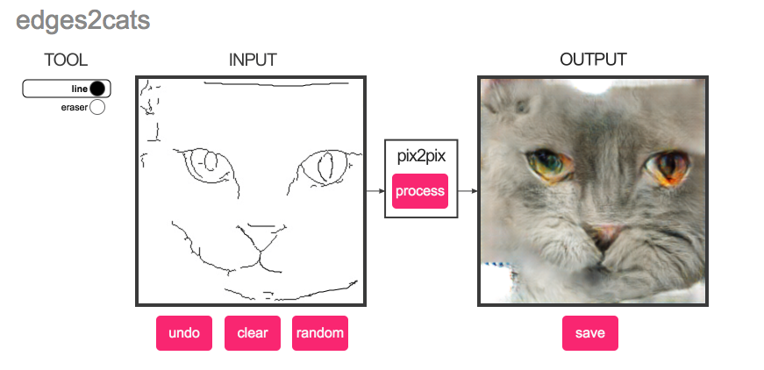
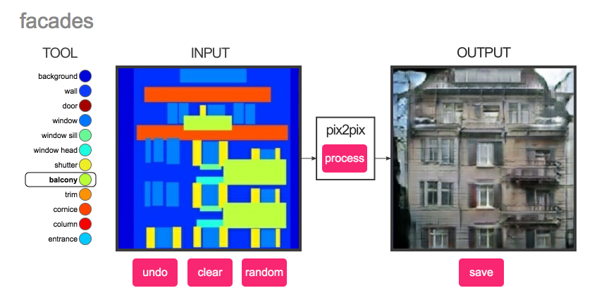
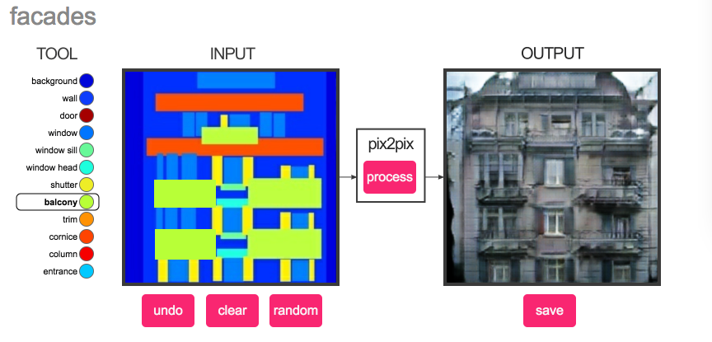
Image to Image
https://affinelayer.com/pixsrv/
Notes:
Alternatively, other applications include sketch to image pairs.
Where for a cat, we can draw elements like an eye or nose to build better features...
Applications could include what if for architects to mix and match design elements...

Slide 11
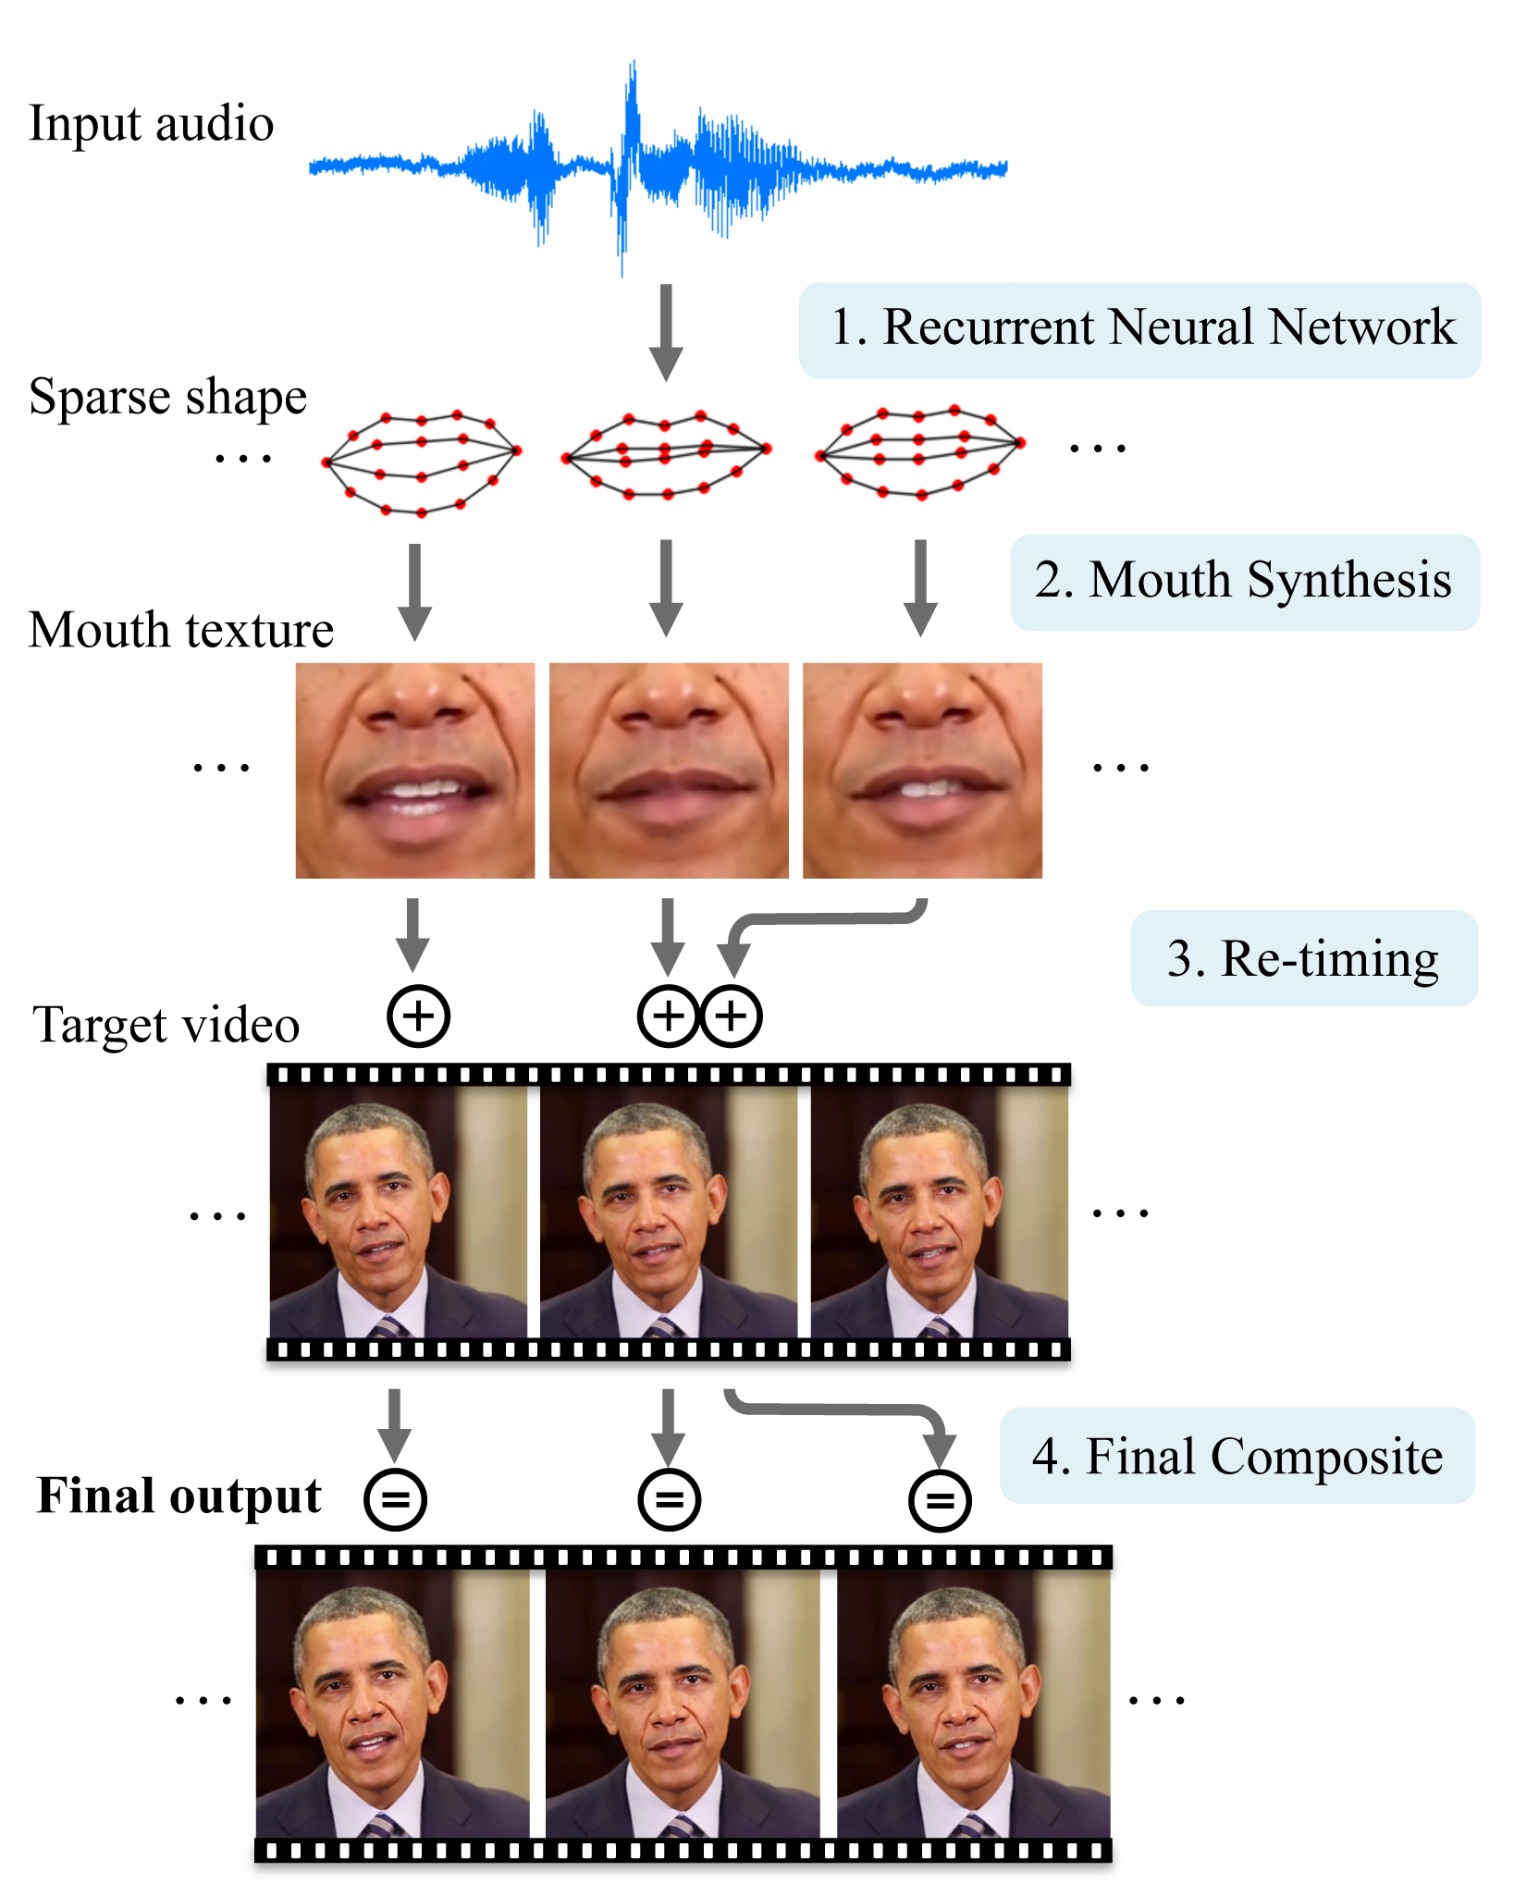
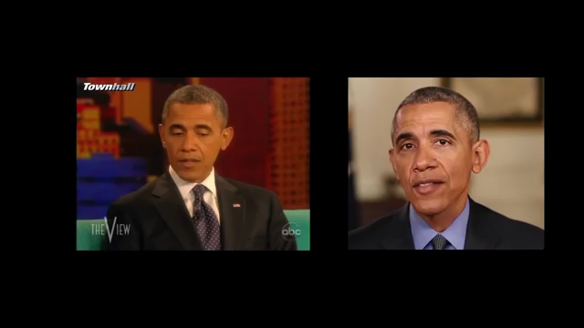
Multimodal
Suwajanakorn, Seitz, and Kemelmacher-Shilzerman (2017)
Notes:
Alternatively, deep learning can handle different types of data – images, video, audio, text – and combine them (multi-modal).
In a paper by a team of University of Washington, researchers mapped audio to video to allow new audio to generate similar video.
In their example, they used new audio of Barack Obama to create mapped video footage... [show first... then skip to second video]...
Definitely will put a new spin on fake news...

Slide 12
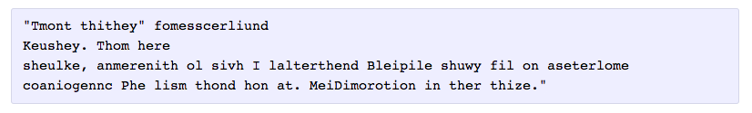
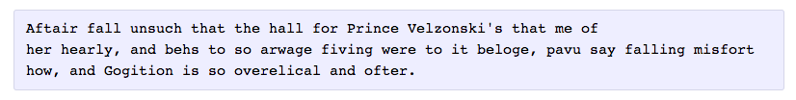
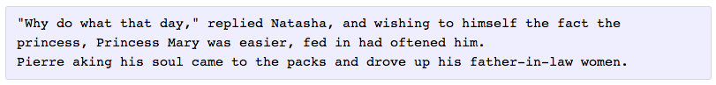
Deep Dreaming Tolstoy
100 iterations
300 iterations
700 iterations
2,000 iterations
Andrej Karpathy
Notes:
If you have a large enough collection of text – for example, Tolstoy – recurrent neural net models can generate new text… or “dream”…

Slide 13
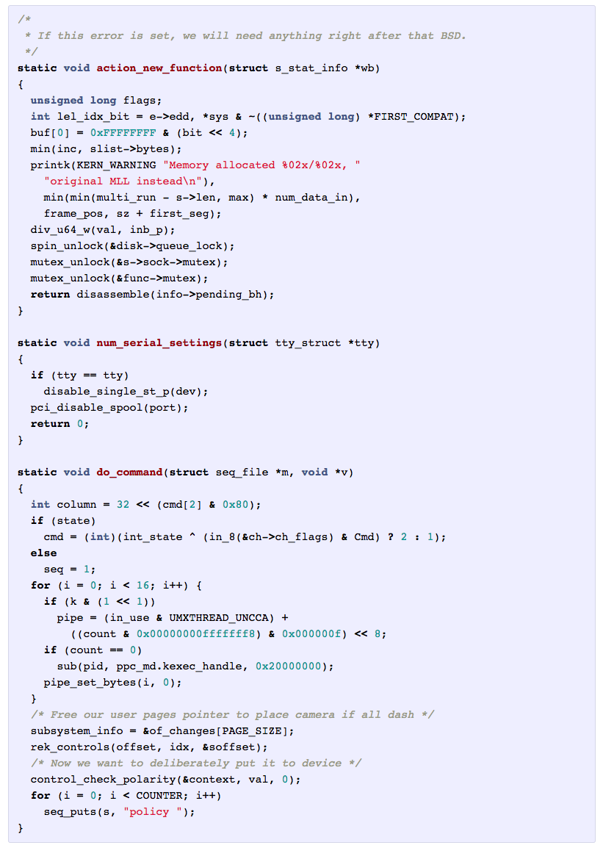
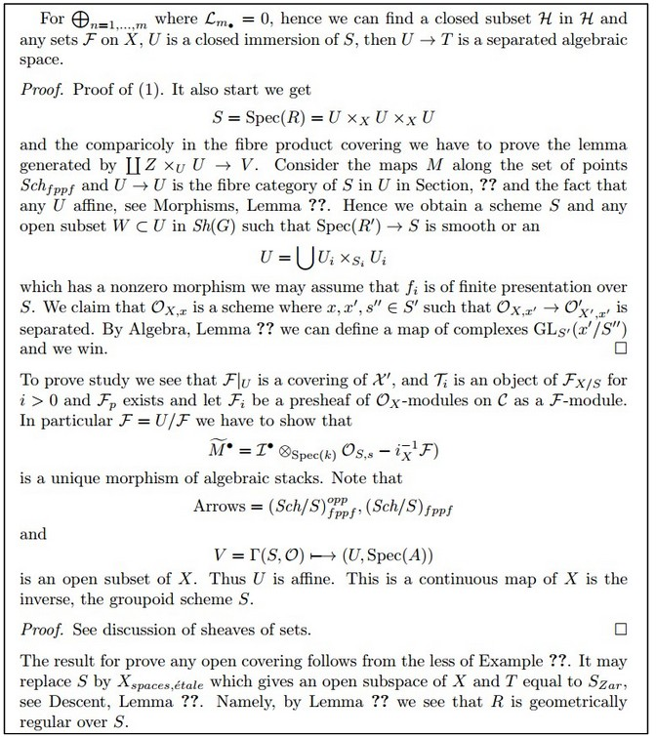
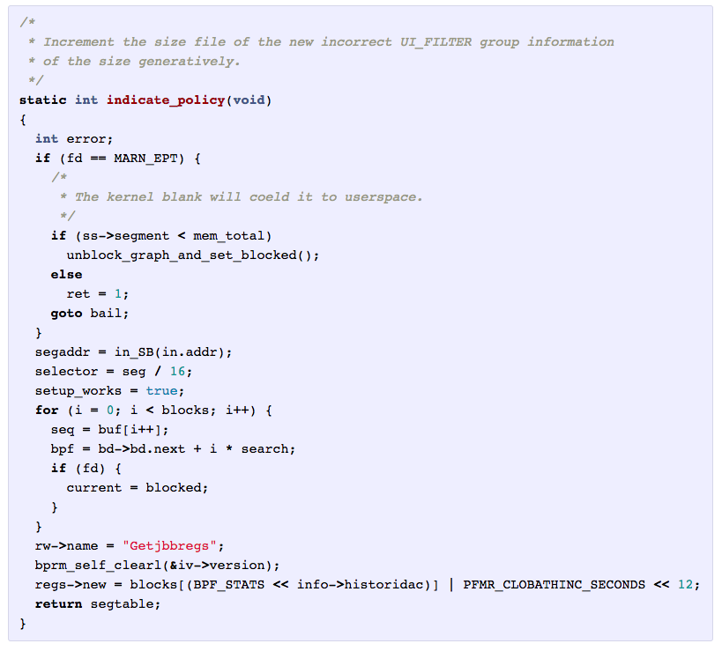
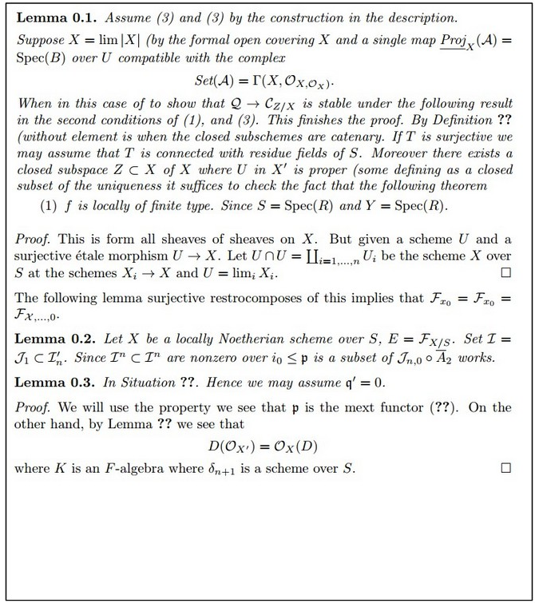
Deep Dreaming: Math & Code
Andrej Karpathy
Notes:
But this works with more general symbols, like math or code...
while the results still are a blur, the hope is that such generation could provide more training examples or new forms of creativity (and scale) beyond what human could do on

Slide 14
What is Deep Learning?
xkcd

Slide 15
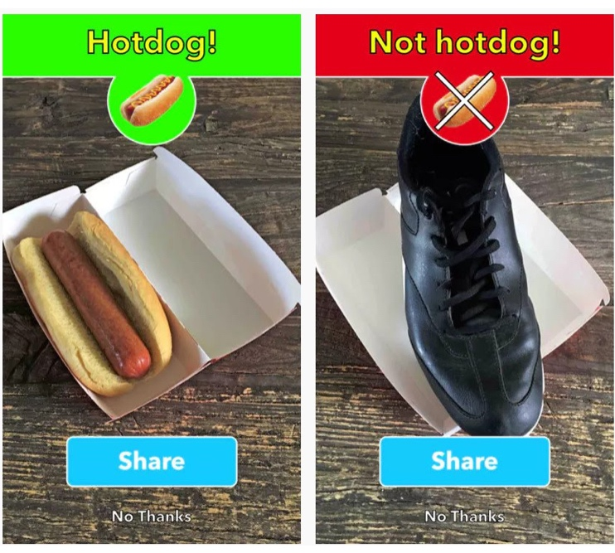
Not Hotdog App, Apple App Store

Slide 16
“Club Sandwich”
Layer 1 Layer 2 Layer 3 Layer 4
Input
Output
Adapted from Chollet (2018)

Slide 17
Spreadsheets on Steroids
Forward pass
Layer 1
representations
Layer 2
representations
Layer 3
representations
Layer 4
representations
(final output)
Original
input
Known label:
“Not Hot Dog”
Backpropagation (“error correction”)
Adapted from Chollet (2018)
Notes:
“Ai is deep learning, and deep learning is backprop” (Somers, 2017)
Need for Supervised Learning.
Idea is teach large neural network to excite specific neurons (can think of images) that are related to features.
For example, it may detect the edges but edges of a hotdog. It builds this network through a process called backpropagation.
But while this may seem abstract, you can think of this as a tons and tons of matrix multiplication or a “spreadsheet on steroids.”
To do this, first, you pass an image… quantified by its pixel, the smallest unit of an image, color as numbers in a red-green-blue scale. Then you pass an image to get the model’s output. But then, you work backwards, using matrix multiplication and calculus to do a sensitivity analysis to the model’s parameters where you can find how to best “improve” or “error correct” the model.
One individual items may not make much of a different. But with millions of records and high computing power, small corrections can propagate into
https://ml4a.github.io/ml4a/how_neural_networks_are_trained/

Slide 18
But it’s a black box.
Original
input
Final
output
Notes:
But the problem is this is a black box.

Slide 19
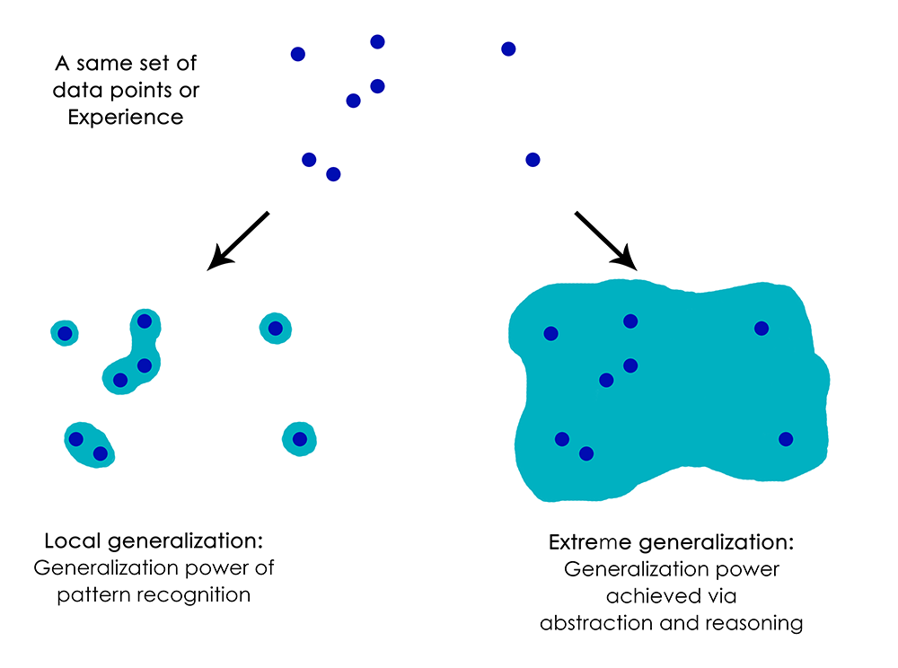
Serious concerns
“For most problems where deep learning has enabled transformationally better solutions (vision, speech), we’ve entered diminishing returns territory in 2016-2017.”
-Francois Chollet (author of Keras library)
Speaking with Axios on the sidelines of an AI conference in Toronto on Wednesday,
Geoffrey Hinton, a professor emeritus at the University of Toronto and a Google researcher, said he is now “deeply suspicious” of back-propagation…
“My view is throw [backpropagation] all away and start again,” he said. Axios
“Deep learning thus far cannot inherently distinguish causation from correlation”
-Gary Marcus (NYU Professor and author of “Deep Learning: A Critical Appraisal” )
Notes:
Chollet: diminishing returns
-can’t expect the same gains… maybe new more generalizable tasks
Hinton:
-convolutional neural networks are not “psychologically correct”
-large, inefficient “frankensteins” that are very powerful, but data hungry

Slide 20
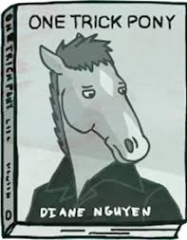
Is Deep Learning hitting a wall?
Is it generalizable or a one trick pony?
Somers, 2017, “Is AI Riding a One-Trick Pony?”
Notes:
Is Deep Learning hitting a wall.

Slide 21
Practical problems
Supervised / labels are expensive!
Needs lots of data
Expensive to build (GPUs)
Can use pre-trained, but likely need to customize
Architecture & tuning hyper-parameters
Rare skill (only few years old!)

Slide 22
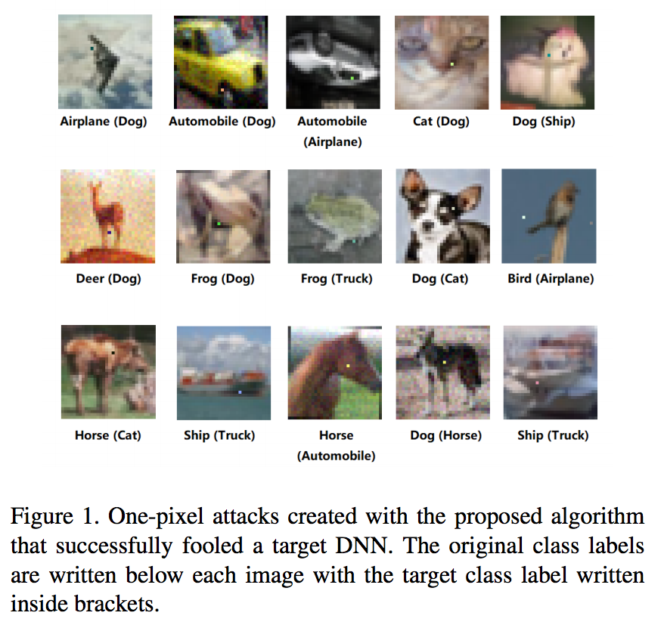
Adversarial examples
Su, Vargas & Kouichi (2018)

Slide 23
Adversarial examples
Carlini and Wagner (2018)
Notes:
Adversarial examples are hard to defend against because it is difficult to construct a theoretical model of the adversarial example crafting process. (source https://blog.openai.com/adversarial-example-research/)

Slide 24
Algorithmic Bias
Crawford (2017)

Slide 25

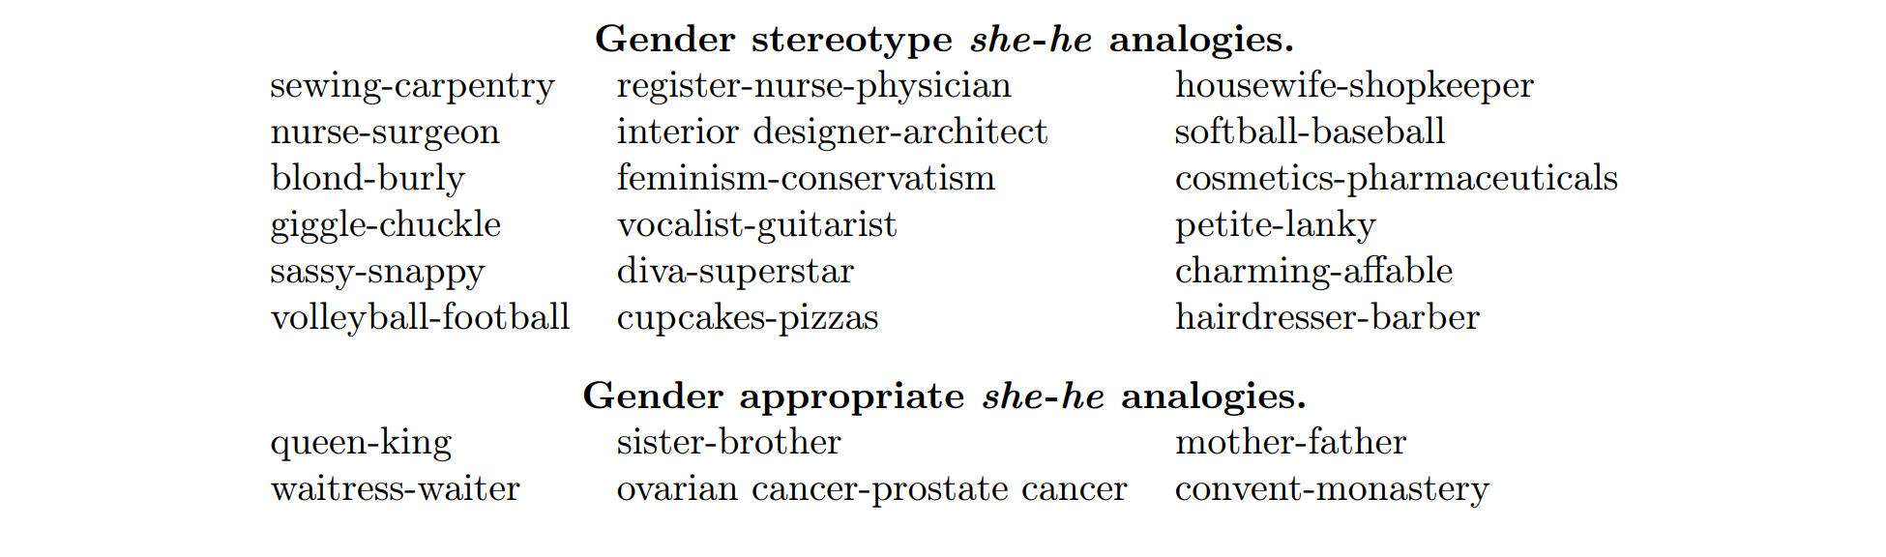
Analogies & Bias
TensorFlow
Bolukbosi et al. (2016)
Notes:
Variety of algorithmic bias… denigration
The proliferation of these algorithmic biases imply learnings about the bias that already exist in the real world…
One related modeling is called word embeddings, in which word context defines meaning, so a world is defined by the words that surround it in text. This is powerful because it allows words to transform their counts into transformed data that has geometric properties. For example, they work

Slide 26
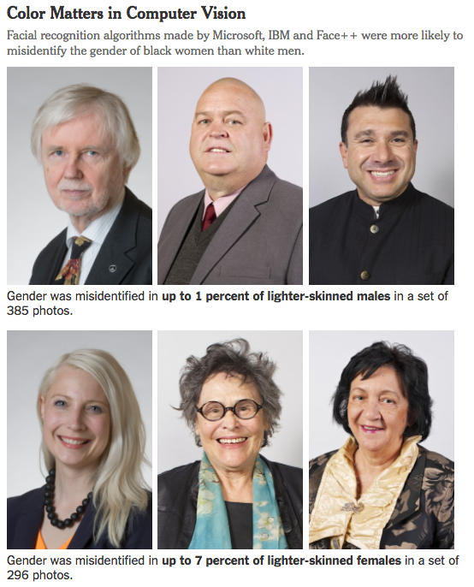
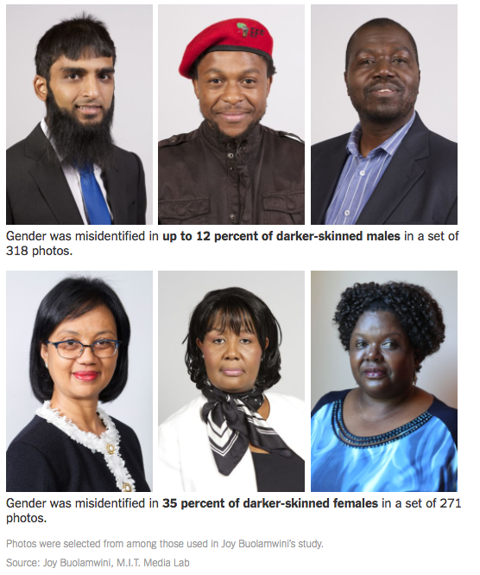
New York Times (2018)

Slide 27
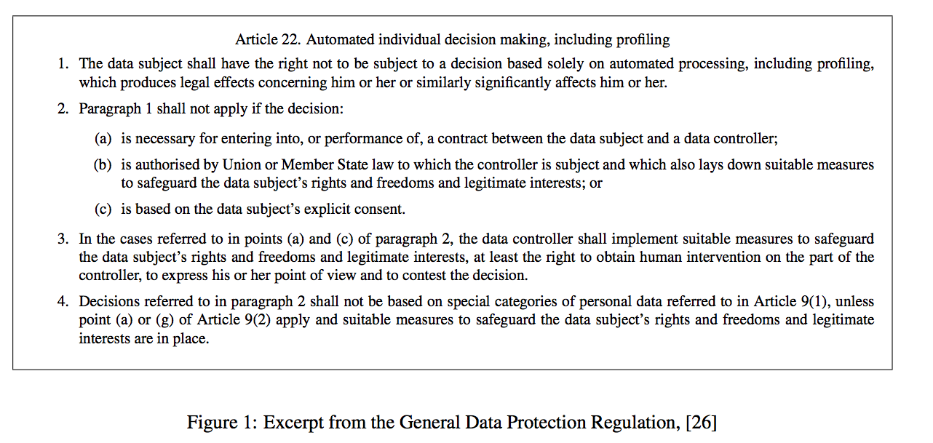
“Right to Explanation”
Goodman and Flaxman (2016)
Notes:
https://arxiv.org/abs/1606.08813

Slide 28
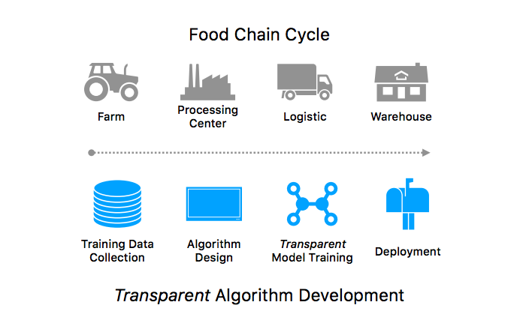
“Algorithm” Food Chain
Thelisson, Padh, and Celis (2017)
Notes:
https://arxiv.org/abs/1606.08813

Slide 29
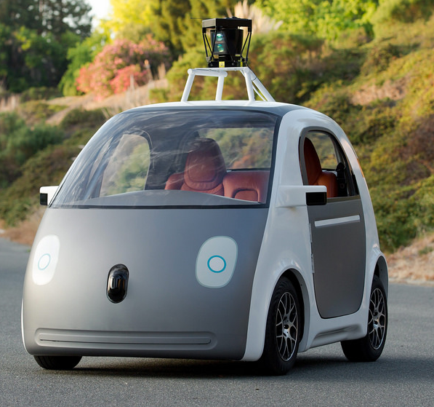




Speed
Deep Learning & Machine Learning (No Human Judgment)
Applications ideal for Explainable AI
“Human-in-the-loop”
Human Judgment
Scale
Severity
Different Decision-Making Process

Slide 30
What is Explainable AI?

Slide 31
Explainable AI (XAI)
Produce more explainable models, while maintaining a high level of learning performance (prediction accuracy);
Enable human users to understand, appropriately trust, and effectively manage the emerging generation of artificially intelligent partners.
DARPA

Slide 32
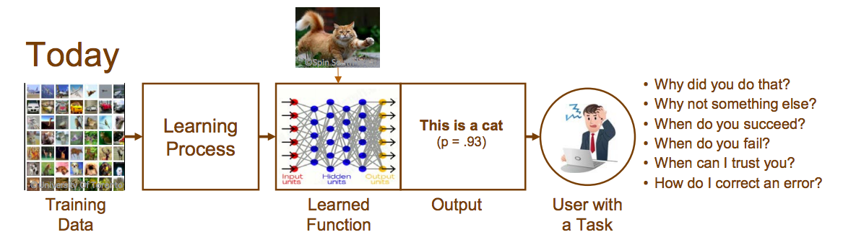
DARPA

Slide 33
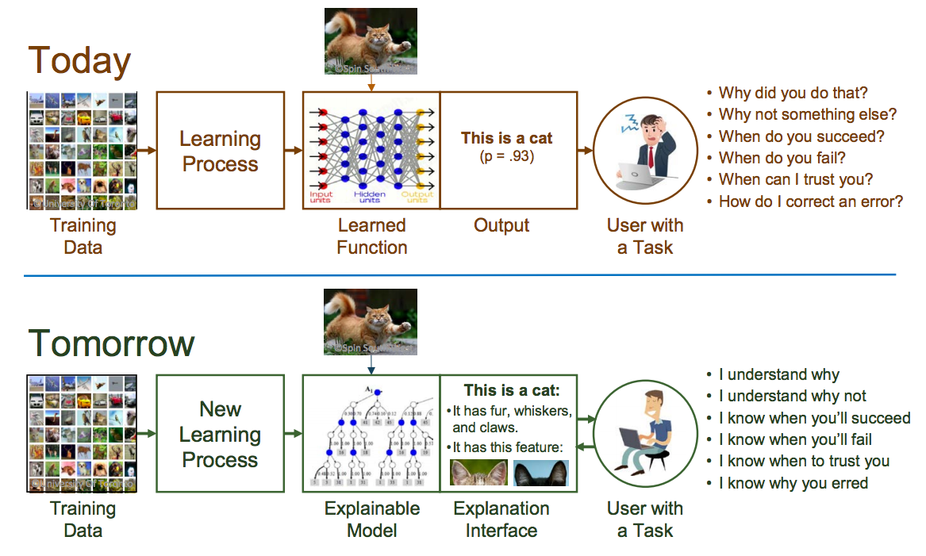
DARPA

Slide 34
DARPA

Slide 35
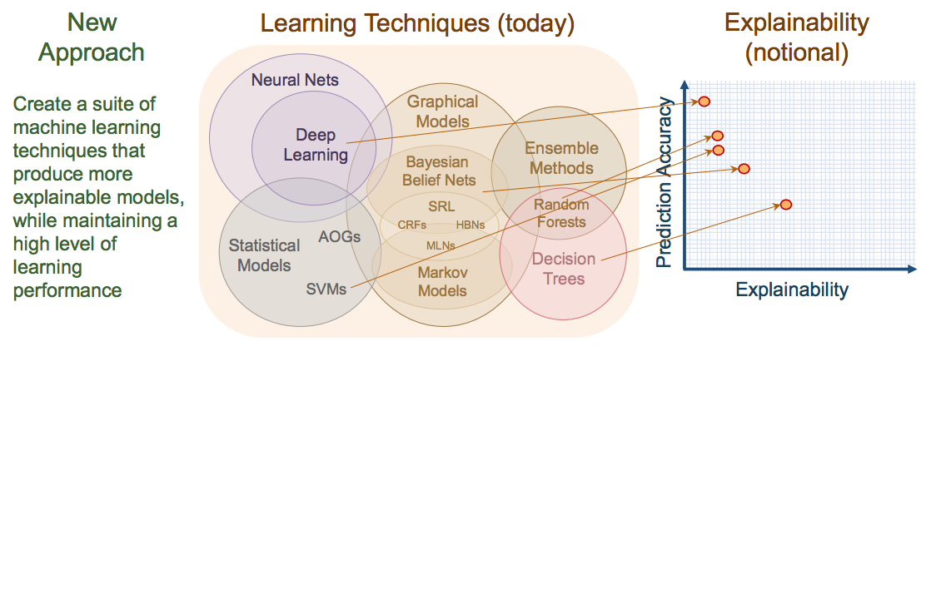
DARPA

Slide 36
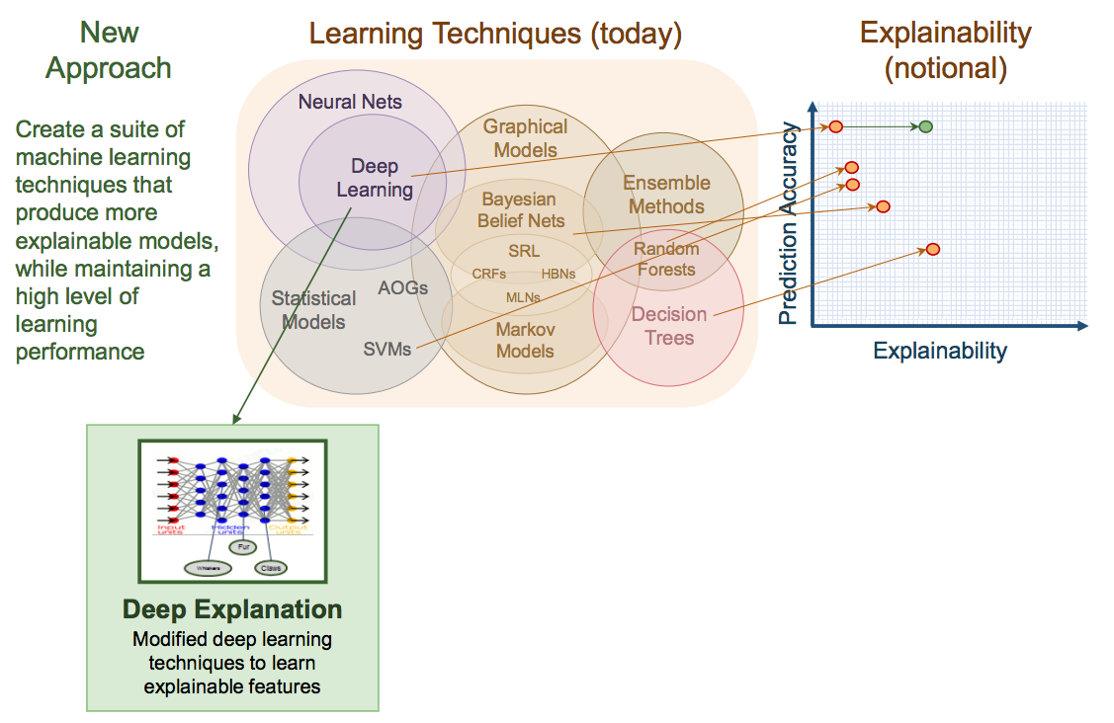
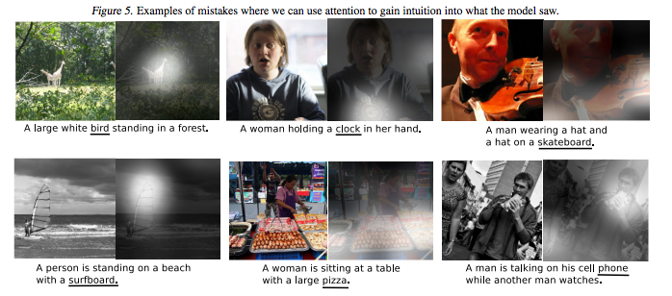
Xu et al. (2016)
DARPA

Slide 37
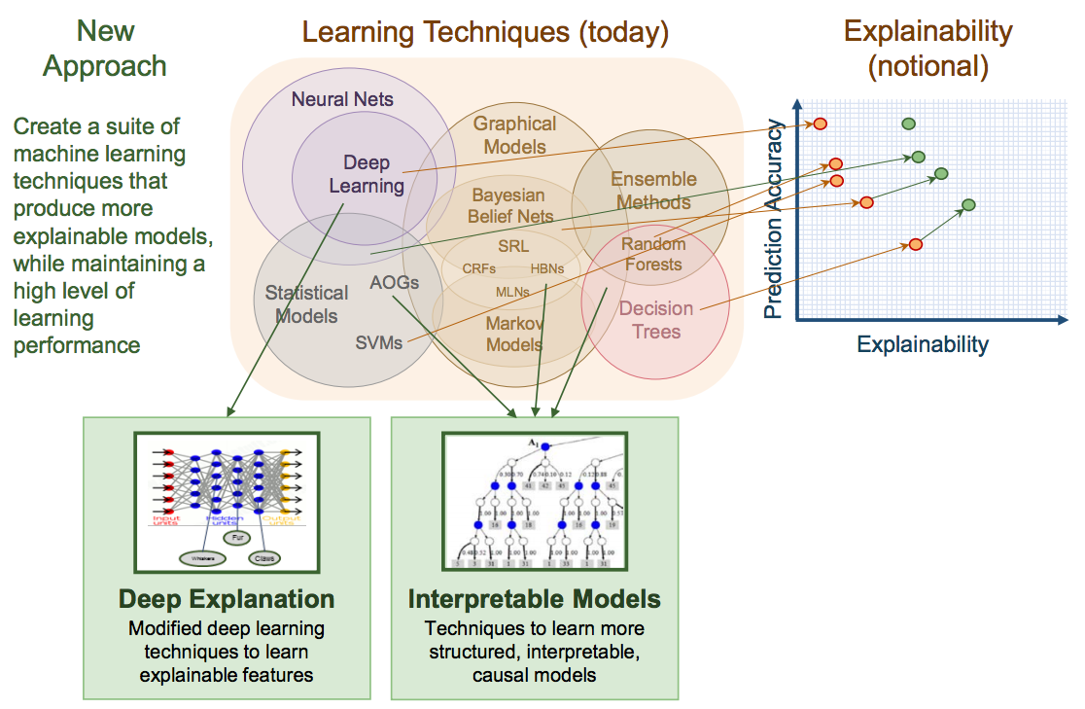
DARPA

Slide 38
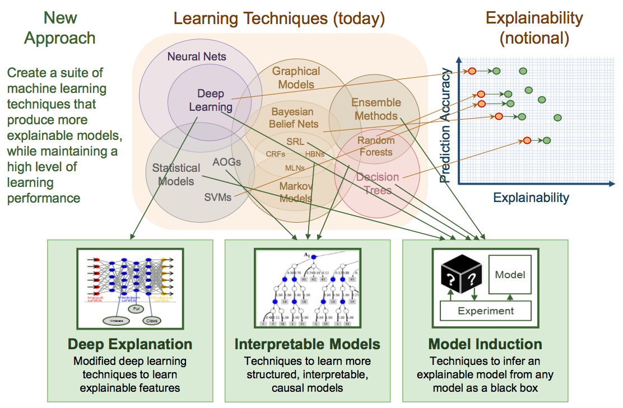
DARPA

Slide 39
DARPA

Slide 40
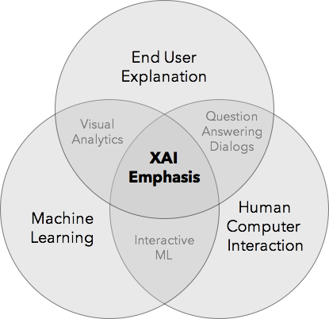
“Human in the Loop”
DARPA

Slide 41
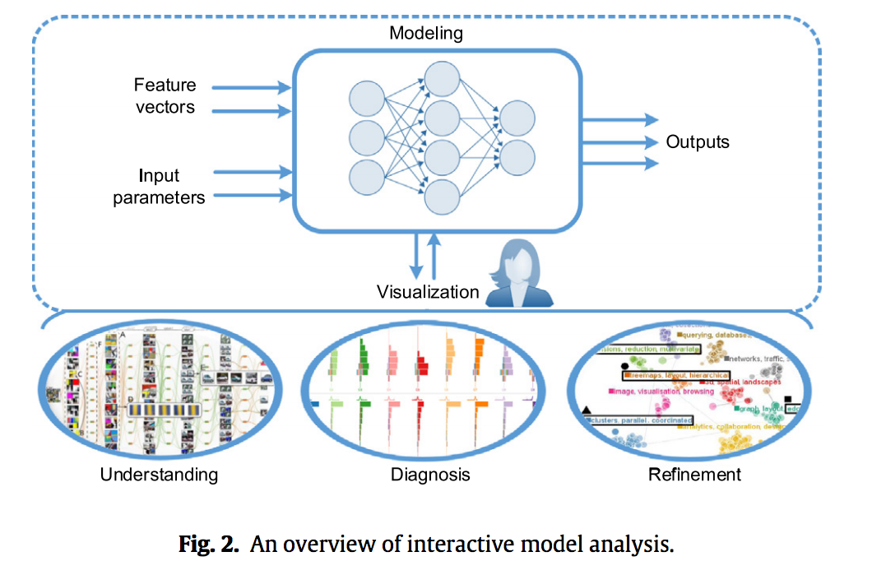
Liu et al. (2017)

Slide 42
Interactive Text Analysis
Choo et al (2013); Liu et al. (2017)

Slide 43
DARPA

Slide 44
DARPA

Slide 45
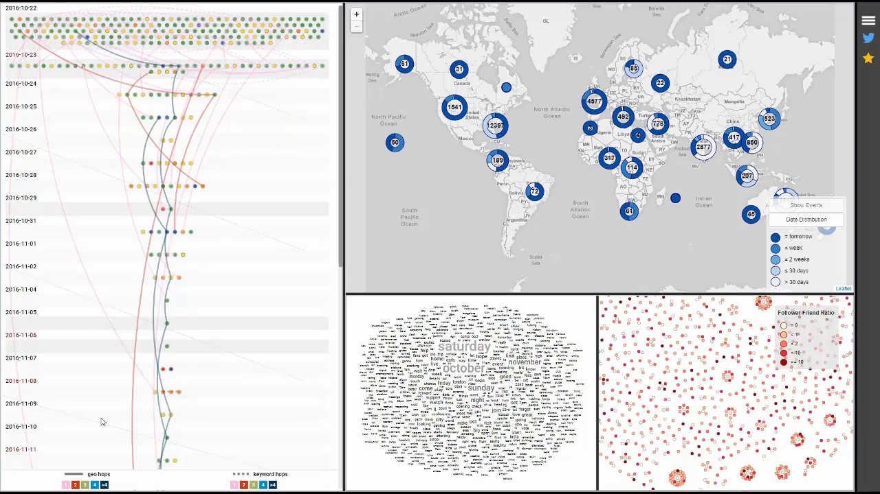
Twitter Event Detection
Cho et al. (2017a)
Notes:
What makes it challenging is the size and volume millions of million of tweets… event detection is important to find needles in haystacks… in a recent paper, my team led by Isaac Cho developed Crystal Ball, an interactive visual analytics interface for detecting global events via Twitter in the present and future.
Using natural language processing, we identified time-location pairs that allowed users to examine across time or location. This coordinated views system provides users its recommendations of significant events… and it’s the users’ task to determine that predicted event’s legitimacy.

Slide 46
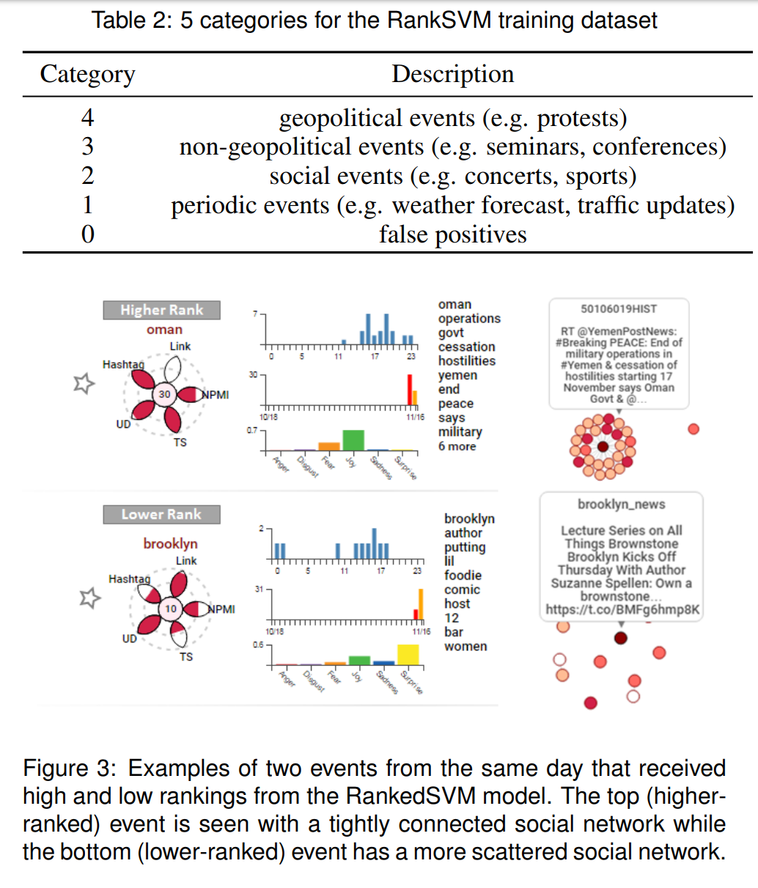
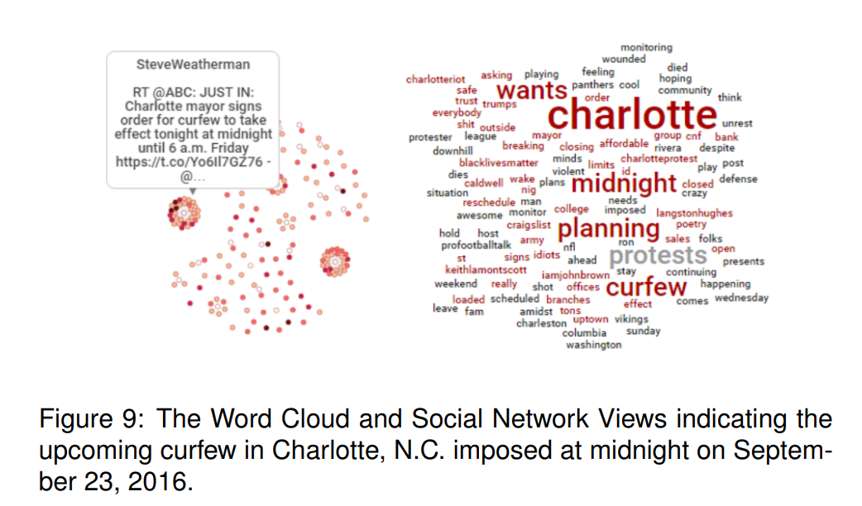
Event Detection
Cho et al. (2017a)
Notes:
Some examples could include spontaneous protests like

Slide 47
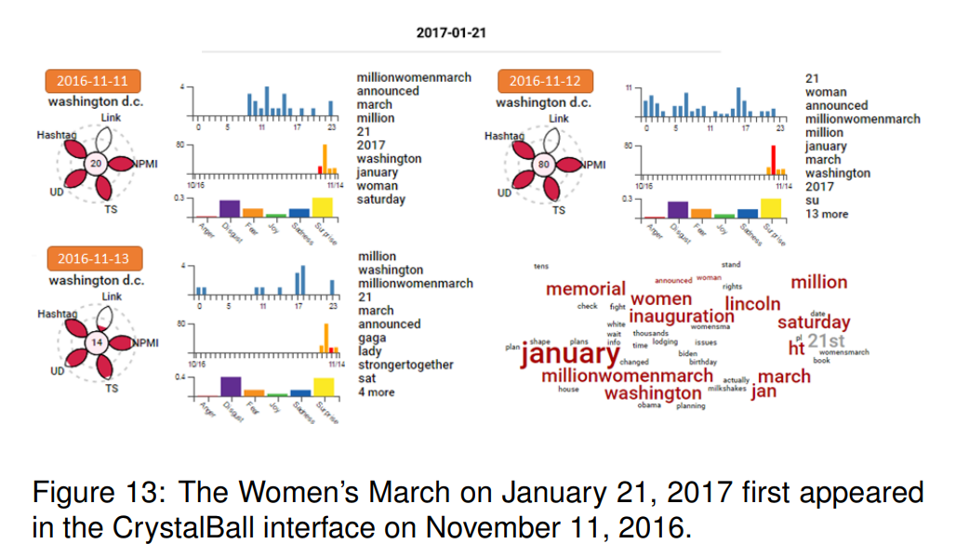
Women’s March
Cho et al. (2017a)

Slide 48
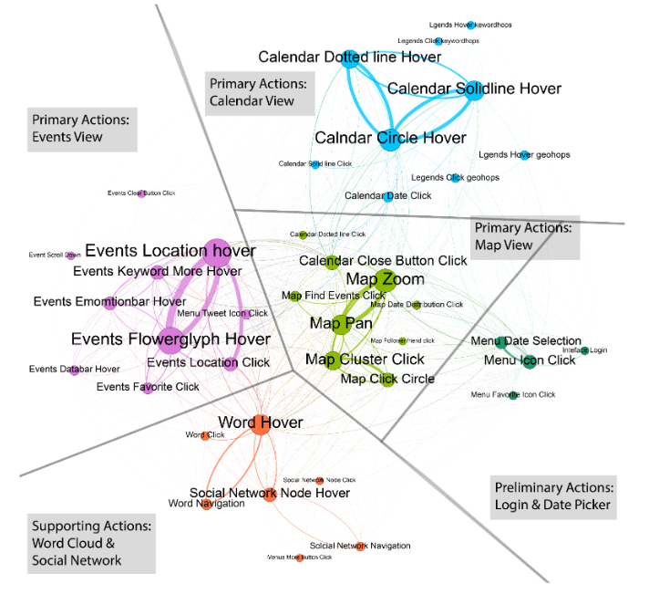

Analyzing User Interaction Logs
Cho et al. (2017b)

Slide 49
Anchoring Bias in Visual Analytics
User Interaction Log Network:
Users Anchored to the Spatial (Map) View
Users Anchored to the Calendar View
Cho et al. (2017b)

Slide 51
Final Takeaways

Slide 52
Deep Learning History
https://beamandrew.github.io/

Slide 53


Thinking like Social Scientists
Grimmer (2015)
Notes:
Use King quote

Slide 54
A/B Testing & Experiment Design
Jones et al. (2017)
Notes:
https://www.ncbi.nlm.nih.gov/pmc/articles/PMC3834737/

Slide 55
Innate Structures: Nature vs Nurture
Representations of objects
Structured, algebraic representations
Operations over variables
A type-token distinction
A capacity to represent sets, locations, paths, trajectories, obstacles and enduring individuals
A way of representing the affordances of objects
Spatiotemporal contiguity
Causality
Translational invariance
Capacity for cost-benefit analysis
Marcus (2018)
Notes:
https://arxiv.org/pdf/1801.05667.pdf

Slide 56
Data Science teams, not Data Scientists.
Individual
Team
Adapted from O’Neil and Schutt (2013)

Slide 57






















Thank you
wesslen.github.io
@ryanwesslen
rwesslen@uncc.edu

